Slide 1

Intelligent Tweet Analyzer for disaster management
Hetal Mahajan- 21106014
Christina D’Cruz-22106024
Prabudh Gaikwad-2116038
Project Guide
Dr. Rahul K Ambekar

Slide 2
Outline
Introduction
Literature Survey of the existing systems
Limitations of the existing systems
Problem statement and Objective
Proposed System
Experimental Setup(Details about input/ dataset, Performance evaluation parameters, Software and hardware setup)
Implementation(Screenshots of all modules)
Conclusion and future work
References
Research Paper Publication / Patent/ Copyright status

Slide 3
INTRODUCTION
Disaster situations: Social media (e.g., Twitter) becomes a critical real-time information channel.
User contributions: People post about emergencies, request help, offer support, and report updates.
Problem: The volume and variety of posts make it difficult to identify urgent needs quickly.
Proposed solution: Develop an automated system to classify tweets into actionable categories.
Examples: Help Request, Blood Donation, Rescue Update.
Impact: Helps first responders and NGOs prioritize and coordinate their actions more effectively.

Slide 4
OBJECTIVE
To Extract and Tag Locations: Automatically identify and extract geographic locations mentioned in tweets to map affected areas and improve situational awareness.
To Detect Affected Zones: Use tagged locations to highlight clusters of incidents, enabling early detection of crisis hotspots and faster resource allocation.
To Assess Urgency Levels: Implement urgency scoring mechanisms to classify tweets based on severity, ensuring that high-priority cases receive immediate attention.
To Analyze Sentiment for Distress Signals: Apply sentiment analysis to detect emotions such as fear, panic, or distress in tweets, supporting faster and more empathetic emergency response.

Slide 5
Literature Survey of the existing system
Sr. No. | Paper Title | Authors | Review
 | Twitter analysis in emergency management: recent research and trends 2024 | Alireza Arvandi, Jon Rokne, Reda Alhajj | This review explores Twitter's role in emergency management, focusing on data collection, preprocessing, and information extraction from tweets during disasters, highlighting their timely, on-site guidance.
2. | Social response and Disaster management: Insights from twitter data Assimilation on Hurricane Ian 2023 | Mohammadsepehr Karimiziarani, Hamid Moradkhani | This paper uses NLP techniques to analyze 20 million tweets from Hurricane Ian, classifying humanitarian content and exploring public responses, providing insights for disaster preparedness and response strategies.

Slide 6
3. | Twitter for disaster relief through sentiment analysis for COVID-19 and natural hazard crises 2021 | Shivam Behl, Aman Rao, Sahil Aggarwal, Sakshi Chadha | The study compares supervised learning models, focusing on a Multilayer Perceptron for classifying tweets into resource needs, availability, or neutral categories, achieving 83% accuracy.
4. | Disaster Analysis Through Tweets 2015 | Himanshu Shekhar, Shankar Setty | The paper introduces a tweet-based interface for natural disaster analysis, utilizing sentiment classification to gauge distress levels, visualize emotions, and provide a cost-effective alternative to traditional methods.
3. | Twitter for disaster relief through sentiment analysis for COVID-19 and natural hazard crises 2021 | Shivam Behl, Aman Rao, Sahil Aggarwal, Sakshi Chadha | The study compares supervised learning models, focusing on a Multilayer Perceptron for classifying tweets into resource needs, availability, or neutral categories, achieving 83% accuracy.
4. | Disaster Analysis Through Tweets 2015 | Himanshu Shekhar, Shankar Setty | The paper introduces a tweet-based interface for natural disaster analysis, utilizing sentiment classification to gauge distress levels, visualize emotions, and provide a cost-effective alternative to traditional methods.

Slide 7
5. | Usage and analysis of Twitter during 2015 Chennai flood towards disaster management | Meera R. Nair , G.R. Ramya , P. Bagavathi Sivakumar | This study uses machine learning algorithms like Random Forests to analyze tweet propagation during the 2015 Chennai flood, identifying influential users and sources, highlighting social media's role in crisis information dissemination.

Slide 8
Limitations of Existing Systems
Noisy and Unstructured Data
Limited Applicability Across Disasters
Language and Data Bias
Privacy and Ethical Issues

Slide 9
PROBLEM STATEMENT
Extracting and tagging locations for affected areas: identifying place names (like cities, villages, or landmarks) from data sources and linking them with geographic tags (coordinates or region IDs) to mark which areas are impacted during an event or crisis.
Score urgency and sentiment analysis for distress detection: analyzing text (like social media posts or messages) to measure how urgent a situation is and identify emotions (fear, anger, sadness, etc.), so that signs of distress can be quickly detected and prioritized for response.
Categorizing tweets into actional emergencies: filtering and classifying tweets to identify those that report real, urgent situations (like floods, accidents, or medical help requests) so they can trigger timely response or relief actions.

Slide 10
System Design And Proposed System
AI powered tweet analysis
AI powered scoring engine
Categorizing tweet
Agentic AI
Location extractor

Slide 11
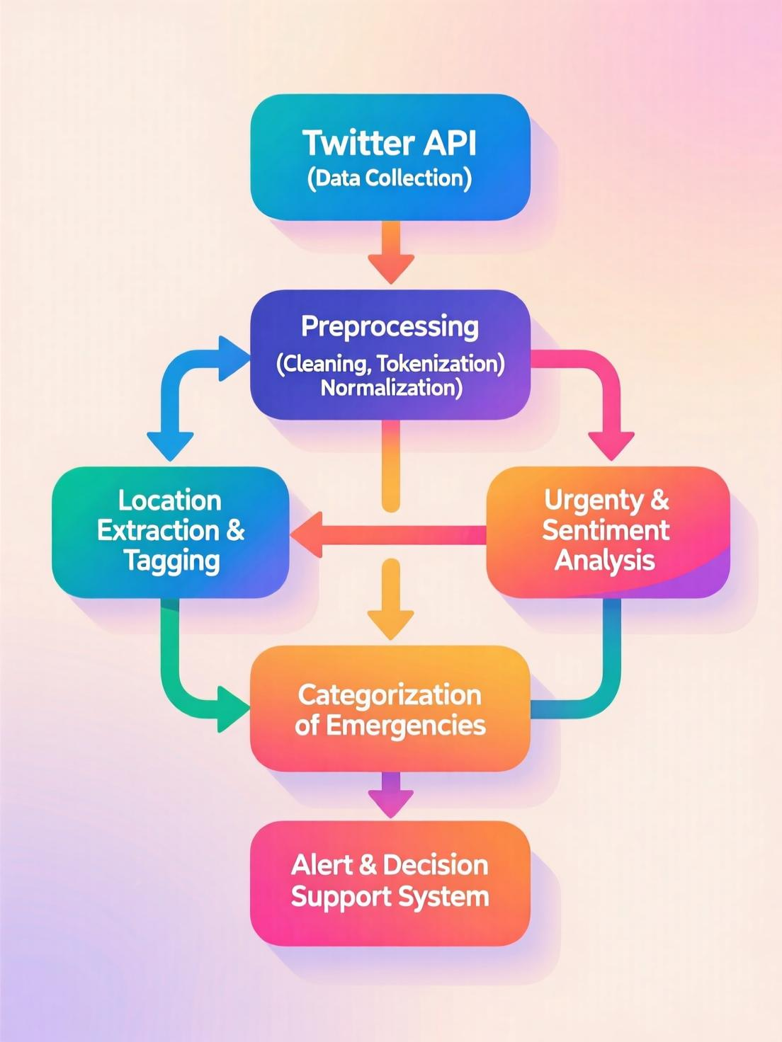

Slide 12
Technologies and methodologies
Currently we trained NLP model that will classify whether it is disaster or not
Dataset:Kaggle-disaster tweets
LLM and Prompt engine
N8N automation tool
Google gemini
Python
Rest API architecture
React
Java script
MCP(model contacts protocol)
A2A protocol

Slide 13
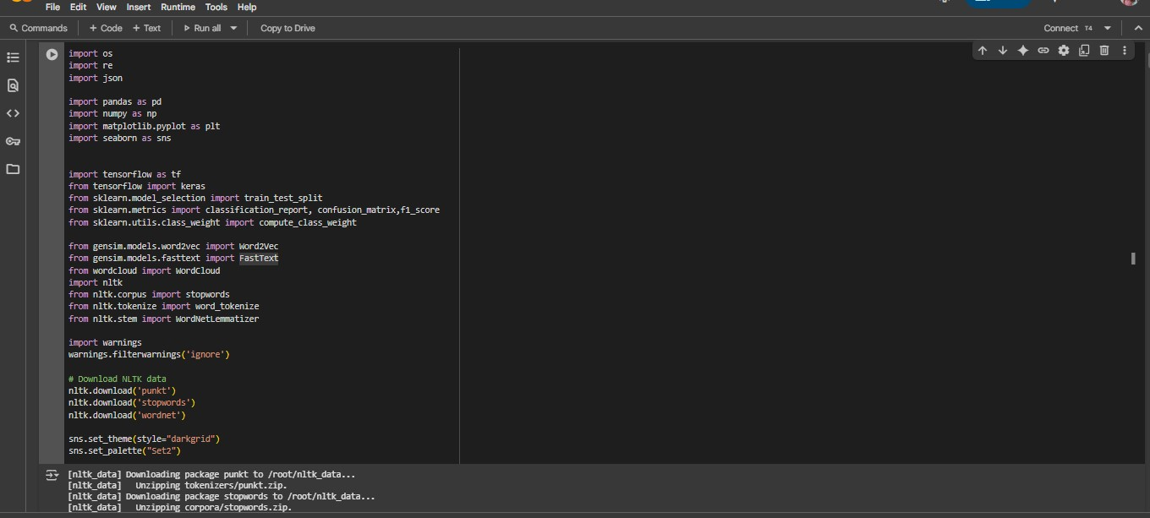
IMPLEMETATION AND OUTPUT

Slide 14
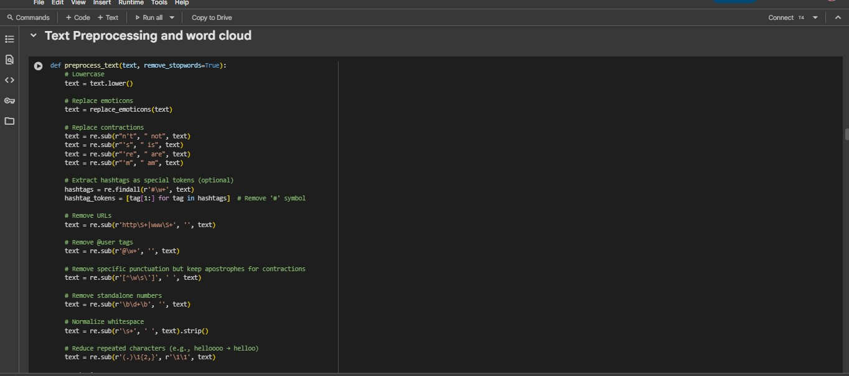
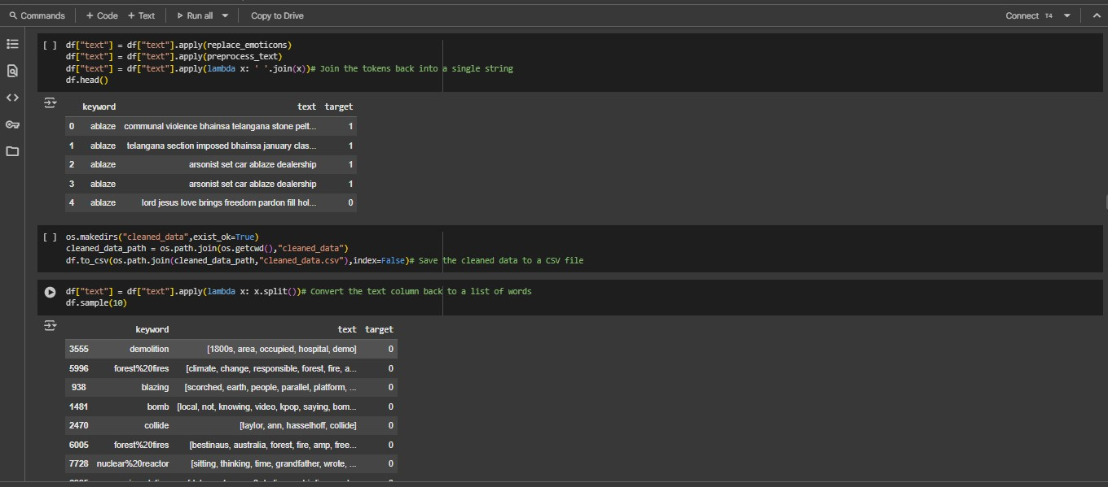

Slide 15
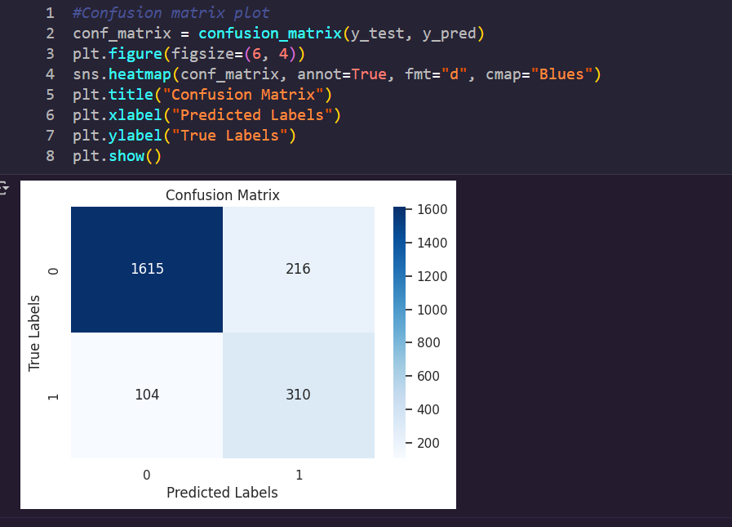

Slide 16
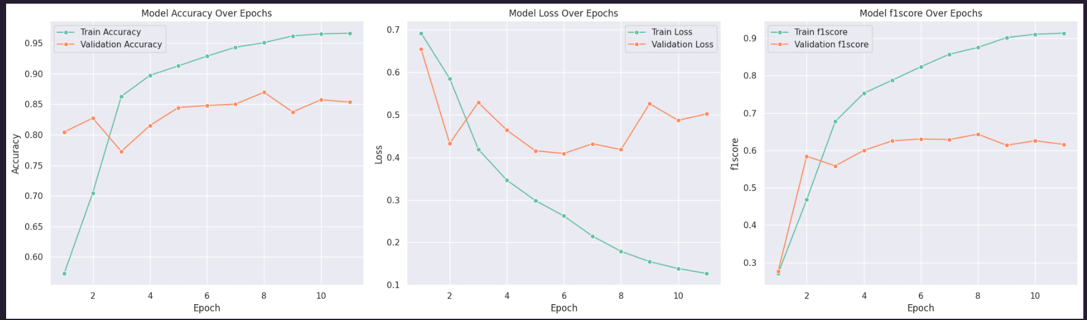

Slide 17
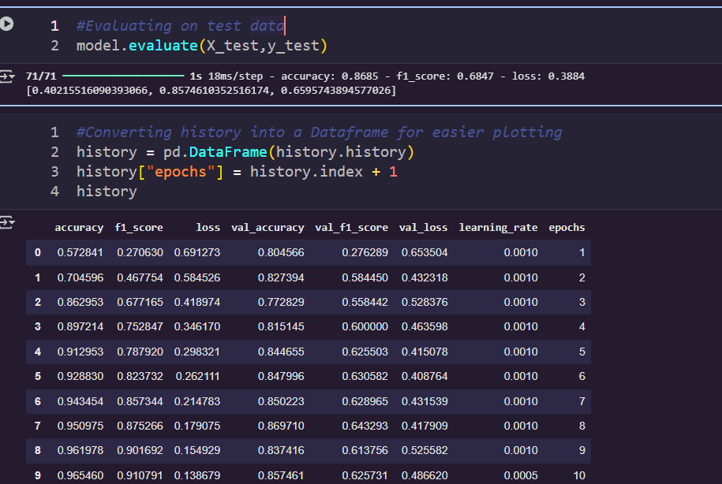

Slide 18
GOAL ALIGNMENT
SDG 3: Good Health and Well-being
SDG 16: Peace, Justice, and Strong Institutions
Social Impact: Faster, smarter response to emergencies and disasters, potentially saving lives by timely detection of help needs and blood requests.

Slide 19
References
[1] https://link.springer.com/article/10.1007/s13278-024-01308-8
[2]https://www.researchgate.net/publication/281768488_Disaster_Analysis_Through_Tweets
[3] https://www.sciencedirect.com/science/article/pii/S2212420921000674
[4] https://www.sciencedirect.com/science/article/pii/S221242092300345X
[5] https://www.sciencedirect.com/science/article/pii/S1877050917319038

Slide 20
Thank You...!!

